Slide 1


Slide 2
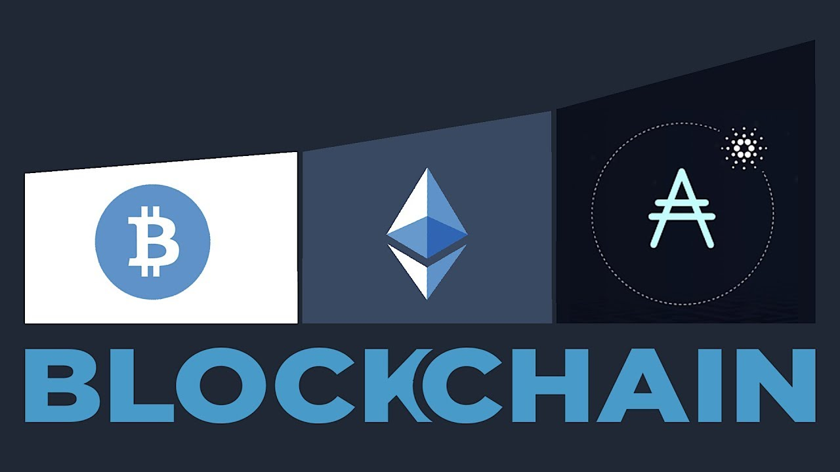

Slide 3


Slide 4
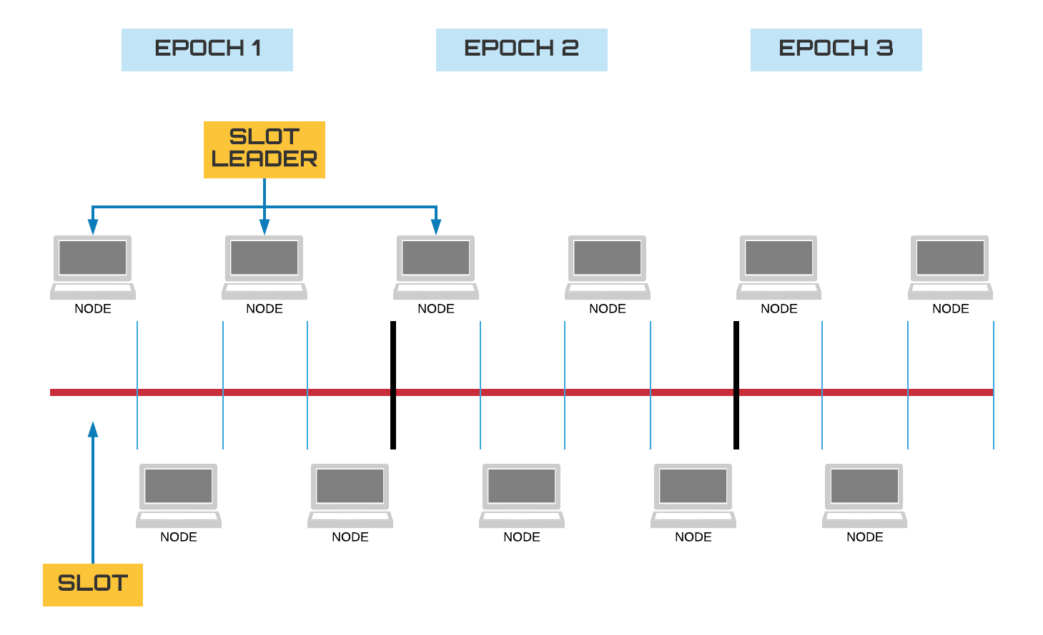

Slide 5
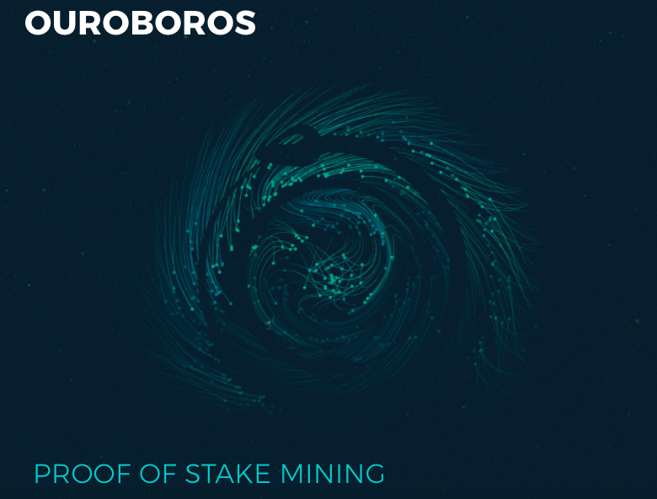

Slide 6


Slide 7
Solutions?
RINA
Storage
“Blockchain of blockchains”
ICO

Slide 8


Slide 9
Questions?

